Slide 1
Skagit County
2022
Preliminary Budget
November 23, 2021
Skagit County

Slide 2
2022 Budget Process
July 12 Budget Call
August 17 Budgets submitted to County Commissioners
October 4-7 Department meetings with County Commissioners
November 22 Preliminary Budget Available
December 6 Public Hearing on Budget and Tax Levies
December 13 Budget and Levy Adoption
Notes:
I’ll start with a little background on the process. Departments officially began working on budgets after the Budget Call on July 12th.
Budgets were due to the County Commissioners on August 17th
Commissioners met (virtually) with departments between October 4th and 7th
From those meetings, a preliminary budget was developed and is now available
There will be a public hearing on the budget 2 weeks from yesterday
Adoption is tentatively scheduled for a week after that

Slide 3
County Budget
Counties are required by law to provide essential services, including law enforcement, prosecution, public defense, court systems, jails, elections, and property assessments.
Property Tax, our single largest revenue source, is statutorily limited to 1% increase plus revenue from New Construction
Notes:
Statutorily, there are certain services that counties are required to provide. These include law enforcement, prosecution, public defense, courts, jails, elections, and property assessments, to name a few.
Property Taxes $29,562,249 (For 2022, 53% of General Fund revenue, about the same as last year)
2nd largest revenue source is sales taxes (22-24% of budget) – 2021 is forecast up 20% from 2020, and back down for 2022
2021 - $14,484,684
2022 - $12,439,625

Slide 4
Countywide Services
57% of General Fund expenses are for Countywide services
Jail
Superior Court
Court Filings (Clerk)
Prosecutor
Juvenile Court
Death Investigations and Autopsies
Defense and Adjudication of Felons
Public Health
Senior Services
Low-Income/Homeless Housing
Mental Health and Chemical Dependency Services
Development Disabilities Services
Assessment of Property
Property Tax Collection
Licensing and Document Recording
Treasurer for Most Local Governments
General Administration
Emergency Management
Emergency Medical Services
Elections, Voter Registrations
Parks, Recreation, Fair
Historical Museum
Cooperative Extension
Notes:
There are a whole host of countywide services that are provided for in this budget – for citizens within city limits, and in the unincorporated area.

Slide 5
All County Funds (49 of them!)
General Fund (1)
Everything not accounted for in a different fund
Special Revenue Funds (36)
Restricted for a specific purpose other than debt or capital
Debt Service Fund (1)
Principal and interest payments on debt
Capital Funds (4)
Acquisition or construction of capital facilities or other assets
Enterprise Funds (3)
Activities for which a fee is charged to external users
Internal Service Funds (4)
Provide service within our government, or to other governments, on a cost reimbursement basis
Notes:
In order to account for the services provided, we budget in 49 separate and unique funds.
Added ARPA but closed River Improvement

Slide 6
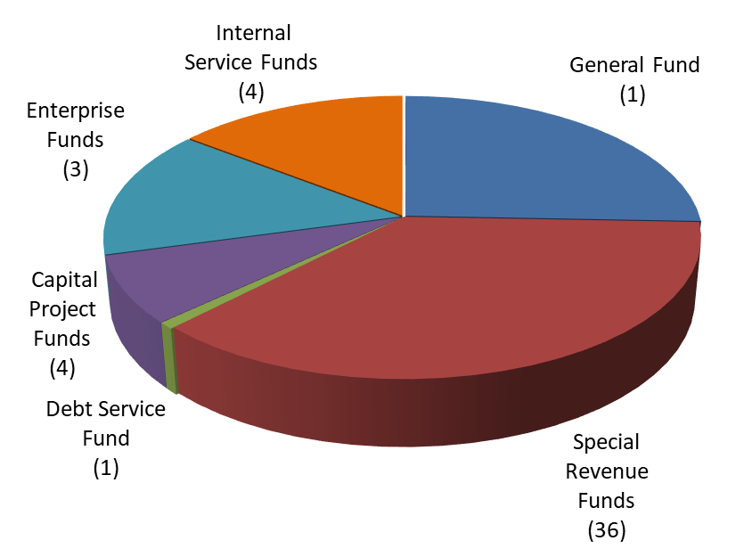
County Budget – All Funds
Notes:
Pictorial representation of all funds
General Fund is for general gov’t purposes and some discretionary services. All other funds are dedicated and/or restricted.
General Fund 66,437,137 (25%)
Special Revenue Funds 106,012,472 (39%)
Debt Service Fund 1,940,598 (1%)
Capital Project Funds 17,202,062 (6%)
Enterprise Funds 39,636,101 (15%)
Internal Service Funds 38,345,454 (14%)
Total $269,311,896
Revenue $237,010,384

Slide 7
Special Revenue Funds
•Public Health ($5,093,800)
•Special Paths ($186,829)
•Tourism Promotion Area ($380,000)
•Emergency Management ($656,241)
•Fairgrounds ($551,570)
•Veterans Relief ($264,613)
•Law Library ($139,917)
•Treasurer’s O&M (no budget required)
•Centennial Document Preservation ($127,189)
•Elections ($1,002,900)
•Parks & Recreation ($1,948,770)
•Substance Abuse ($985,536)
•Mental Health / Developmental Disability ($8,752,619)
•County Roads ($36,038,546)
•Senior Services ($2,349,837)
•Convention Center ($500,000)
•Clean Water ($1,695,208)
•ARPA ($1,200,879)
•Conservation Futures ($2,006,918)
•EMS ($9,295,656)
•Crime/Victim Services ($127,125)
•Communication System ($5,175,000)
•Planning & Development Services ($4,761,273)
•Lake Management Dist#1-4 ($195,316)
•Edison Clean Water Dist ($80,467)
•Drug Enforcement Cumulative Reserve ($3,000)
•Boating Safety ($70,576)
•Low Income Housing ($750,475)
•Title III Projects($0)
•Treasurer’s REET ($0)
•Homeless Housing & Assistance ($21,127,234)
•Housing & Community Development Revolving Loan ($100,000)
•Interlocal Investigation ($437,578)
Notes:
Here is a listing of all the County’s Special Revenue Funds and their expense budget.
This is about 39% of the total County Budget
Funds are NOT discretionary and are required to be spent on a specific purpose and cannot be spent elsewhere.
I want to specifically highlight ARPA at $1.2 million and Homeless Housing – mostly eviction prevention and assistance at $21 million

Slide 8
Debt Service Fund
Outstanding debt for Commissioners’ Admin Building, Ventilation and Cooling for Downtown Admin Building, building on Continental Campus, PFD, Water Quality Loans
2021 Preliminary Budget - $1,940,598
Notes:
This, of course is also non –discretionary and is about 1% of the overall County budget

Slide 9
Capital Funds
Facility Improvement $4,461,656
Real Estate Excise Tax $4,704,784
Economic Development $5,958,064
Park Improvement $2,077,558
Notes:
Facility Improvement is various capital projects – largest is removal of 4th floor of CH
REET is for facility improvement, park improvement, $1,000,000 for homeless housing
Economic Development is for awarded projects that create/retain family wage jobs
Largest project in Park Improvement is NSRA Veterans Park @ $0.5 Million, balance to various other projects
Capital Funds make up approximately 6% of the overall budget

Slide 10
Enterprise Funds
Solid Waste $13,239,836
Drainage Utility $6,863,410
County Jail $19,391,757
Notes:
These funds account for business-like activities and account for about 15% of the total budget

Slide 11
Internal Service Funds
ER&R $6,912,471
Insurance Services $19,391,757
Central Services $11,423,238
Unemployment $617,988
Notes:
These funds provide a service within County government and make up about 14% of the total budget

Slide 12
General Fund
Traditional functions of County government and other day-to-day services that do not have dedicated funding
Assessor
Auditor
Treasurer
Clerk
Commissioners
Coroner
Prosecutor
Sheriff
District Court
Juvenile Court
Superior Court
Assigned Counsel
Board of Equalization
Boundary Review Board
Budget & Finance
Civil Service
Facility Maintenance
Hearing Examiner
Human Resources
Noxious Weed Control
Public Defender
Notes:
The next few slides refer specifically to the County’s General Fund which is about 25% of the County’s total budget
This is listing of services provided that DO NOT have dedicated funding and instead must be paid for from General Fund resources – like property tax, sales, tax, fees for service, etc.

Slide 13
General Fund Budget
2021 Budget
Rev – $54,568,381
Exp – $65,166,881
2022 Preliminary Budget
Rev – $55,512,702
Exp – $66,058,666
Projections
Rev – $59,397,865
Exp – $63,206,868
2022 Supplemental Budget
Rev – $172,235
Exp – $378,471
Notes:
2021 modified budget - $10.6 million spending of reserves
2021 projections - $3.8 million spending of reserves (Bolstered w/$2.8 million in sales tax)
2022 preliminary budget - $10.7 million spending of reserves
This leaves an ending fund balance of $12.2 million, which is $1.15 million over the recommended best practice amount of 2 months of reserves or $11.1 million

Slide 14
Sources of General Fund Revenue
Notes:
You can see here that more than half of the County’s General Fund revenues come from property taxes. A reminder that this revenue source is limited by statute to 1% over the prior year, plus any revenue generated from new construction.

Slide 15
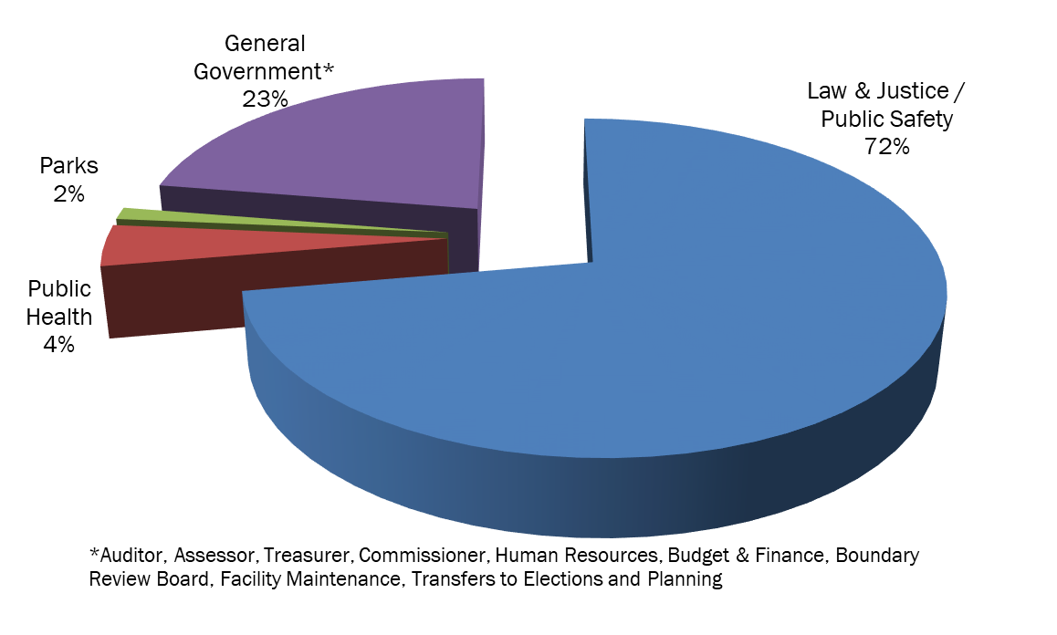
Uses of General Fund Resources
Notes:
This is how the resources of the General Fund are used.
You will note that Parks and Public Health are shown here with very small percentages. This is not the entire budget for those services. Rather, it is the portion of the General Fund that supports those services.
Law & Justice – BOE, Civil Svc, Clerk, Coroner, District Court, Public Defender, Hearing Examiner, OJC, PA, Sheriff, Superior Court, Noxious Weeds, Jail Transfer, Assigned Counsel, Mediation Services, Law Library transfer
In the General Government category, the departments are listed at the bottom of the chart.
For 2022, the General Fund will provide about 59% of PDS revenues
Elections support varies depending on the Election cycle
All categories include an appropriate allocation of shared non-Departmental expenses.

Slide 16
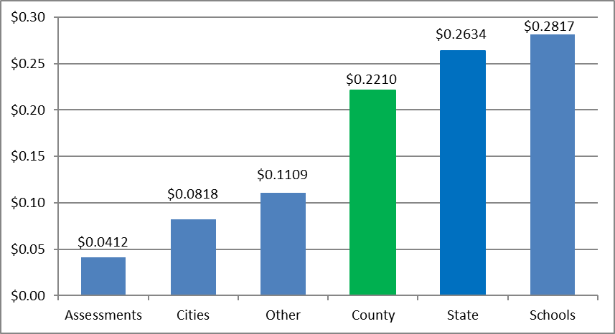
Where do our Property Taxes go? (For every $1)
Notes:
Shifting now to property tax levies
We regularly receive comment and questions on how much tax revenue the county receives and how it is used.
This chart shows how property taxes are distributed after collection.
While the County Treasurer is required to collect and distribute property taxes and assessments, this shows that the County retains less than a quarter of all taxes and assessments collected.
The bulk of takes paid – more than half – go to the state and schools.
Other Districts – Fire, Hospitals, Port, Cemeteries, Libraries, Parks – receive about 11%
County bar does not include County portion of assessments for Clean Water Program - Shellfish Protection District, Drainage Utility, Dike & Drain, LMD’s, etc. Only taxes. This would equal 1.46 cents per dollar.
County becomes $0.2356 – a decrease from the prior year that was $0.241 – or a little over half a cent

Slide 17
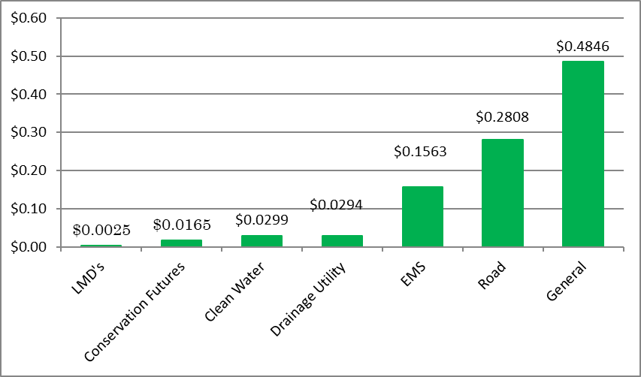
Where does the money go within the County? (For every $1)
Notes:
Focusing on the green bar, that is again a little less than 25% of all taxes collected, this shows how that money is used within the County.
You can see that nearly half of the taxes are retained within the Genereal Fund to provide L&J, general government services, Park, PH, etc.
About 28% of taxes paid are deposited in the Road fund.
A little under 16% are for EMS
The balance are for Drainage Utility, Clean Water, Conservation Futures, and LMDs

Slide 18
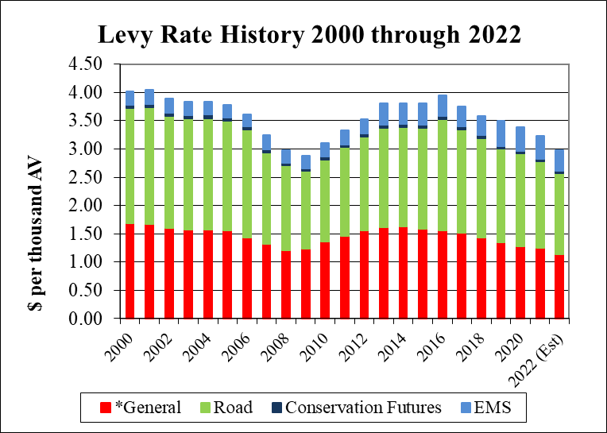
Property Tax Levies
*General Levy includes Veterans Relief and Mental Health
Notes:
This includes PRELIMINARY rates for 2022. The total rate is about 25 cents less than 2021. Again, these are preliminary and the Assessor will calculate the actual rates.
In an economy of rising values, levy rates fall
General Road Cons Fut EMS Total
2000 1.6816 2.0402 0.0625 0.2352 4.0195
2001 1.6776 2.0575 0.0625 0.2500 4.0476 High Voted EMS Levy at 25 cents
2002 1.6018 1.9845 0.0597 0.2391 3.8851
2003 1.5785 1.9560 0.0588 0.2356 3.8289
2004 1.5671 1.9792 0.0581 0.2328 3.8372
2005 1.5526 1.9454 0.0576 0.2306 3.7862
2006 1.4380 1.9100 0.0533 0.2134 3.6147
2007 1.3206 1.6227 0.0469 0.2500 3.2402 Voted EMS Levy at 25 cents
2008 1.2097 1.4973 0.0429 0.2290 2.9789
2009 1.2366 1.3776 0.0424 0.2258 2.8823 Low
2010 1.3628 1.4531 0.0461 0.2461 3.1081
2011 1.4592 1.5702 0.0494 0.2500 3.3288
2012 1.5539 1.6656 0.0527 0.2500 3.5221 Did not take 1% increase
2013 1.6214 1.7557 0.0550 0.3750 3.8070 Voted EMS Levy at 37.5 cents
2014 1.6273 1.7543 0.0559 0.3750 3.8126
2015 1.5909 1.7804 0.0563 0.3750 3.8026
2016 1.5650 1.9637 0.0554 0.3689 3.9529 Correction to Road Levy
2017 1.5140 1.8283 0.0536 0.3568 3.7526
2018 1.4398 1.7535 0.0508 0.3388 3.5829
2019 1.3438 1.6609 0.0474 0.4400 3.4921 Voted EMS Levy at 44 cents
2020 1.2822 1.6344 0.0443 0.4198 3.3806
2021 1.2535 1.5319 0.0425 0.4048 3.2327
2022 1.1338 1.4377 0.0386 0.3694 2.9797
As property values grow, levy rates go down and vice versa.
New Construction 1%
001 - $ 385,810 $ 277,217
117 - $ 206,618 $ 166,724
122 - $ 13,298 $ 9,557
EMS - $ 126,290 $ 90,665

Slide 19
2022 Budget Message:
Facility and technology priorities
Total cost of compensation study and strategic plan update
Body worn cameras
$1M in REET for affordable housing
Notes:
County government faces increasing demands, and for the second year in a row, the Board has proposed a budget heavily reliant on reserve spending in order to meet imperative service needs.
During the first six months of 2022, the Board will work with organizational stakeholders to update the County’s strategic plan. Elected officials and department heads should be preparing for a much leaner 2023 budget, based on work achieved through the strategic planning process.
Facility and Tech priorities are funded with PILT which is not a “guaranteed” source of income every year, so your philosophy has been to spend it on one-time expenses. There is one exception on the next slide
Compensation study & Strategic plan update are also one-time expenses
BWC funded by one-time funding from state for the impact of legislation in 2020 and 2021
Continued support of using REET for affordable housing

Slide 20
2022 Budget Message:
New staffing:
Search and rescue deputy (Sheriff)
Permitting software project management, code compliance, and plans examiner (PDS)
Maintenance worker and operations lands manager (Parks)
Security engineer (IS)
Deputy clerk (Clerk)
Office assistant (Coroner)
Community court case advocate and commissioner (District Court)
Data management specialist (Public Defender)
Data specialist (EMS)
Ferry Operations Manager (Public Works)
Education and outreach coordinator (Public Works)
Notes:
SAR is the one exception to using PILT for one-time expenses. Half funded by PILT ongoing
PDS includes some restructuring of positions to ensure staffing aligns with Commissioners’ priorities and needs of the community
Deputy Clerk is funded 100% with grants for at least 2022
All Community Court expenses are funded with grants or fees for service
PD position is grant funded for at least 2022

Slide 21
Next Steps:
Public Hearing to Consider Budget and Tax Levies
December 6th, 11:00 a.m.
Meeting information posted on Commissioners Agenda
Adoption of Budget and Tax Levies
December 13th, 11:00 a.m.
Meeting information posted on Commissioners Agenda

